Slide 1
Safety Innovation Award
Annually the CSSGA seeks nominations for our Safety Innovation Award. This year there are several recipients.
This is to recognize the outstanding production employee who has made superior innovative contributions to his or her company regarding safety efforts.
The goal is to share best field practices throughout the industry.
Notes:
Let’s switch to safety, which is foremost for all or us. I will say up front you will see a few companies receive awards. Please submit your entries next year, as we know there are many companies performing similar work.
First up is safety Innovation, which was developed to recognize the outstanding production employees who have made superior contributions to his or her company regarding safety innovations.
The goal is to share best field practices throughout the industry. This year there are 2 recipients.

Slide 2

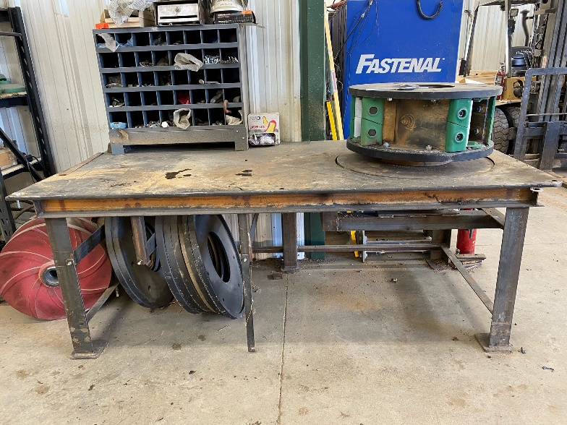
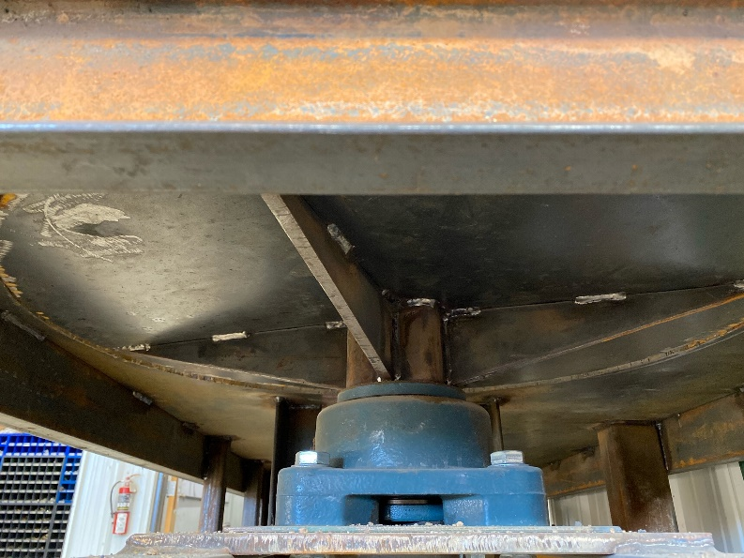
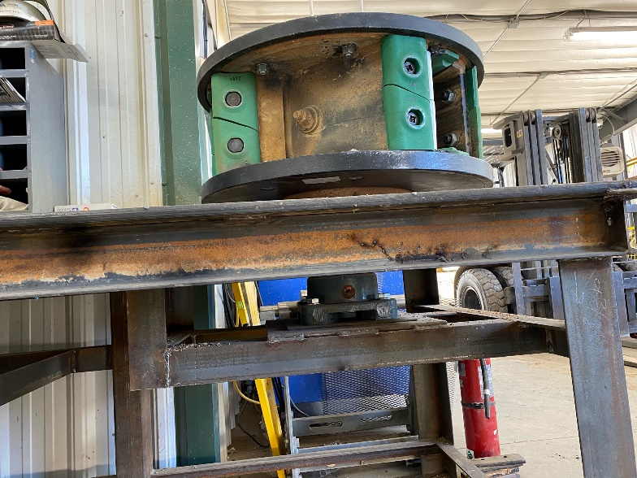
2020 Safety Innovation Award
James “Jamie” Duncan
Martin Marietta
Vertical Shaft Impact Crusher Table
Innovated a 'lazy Susan' type table so that the crusher anvils on a Vertical Shaft Impact (VSI) crusher could be safely and easily changed by a single employee
Notes:
Jamie Duncan, with Martin Marietta innovated a 'lazy Susan' type table so that the crusher anvils on a Vertical Shaft Impact (VSI) crusher could be safely and easily changed by a single employee. Jamie and fellow (retired) coworker Tom Fox fabricated the invention. Most aggregate operations use a 'saw horse' to change these anvils, and the VSI rotor sits vertically on the saw horse, which requires two employees to change these anvils and the process can be more difficult and potentially unsafe. Jamie's innovation also allows a single employee to change these anvils and balance the rotor with ease.

Slide 3
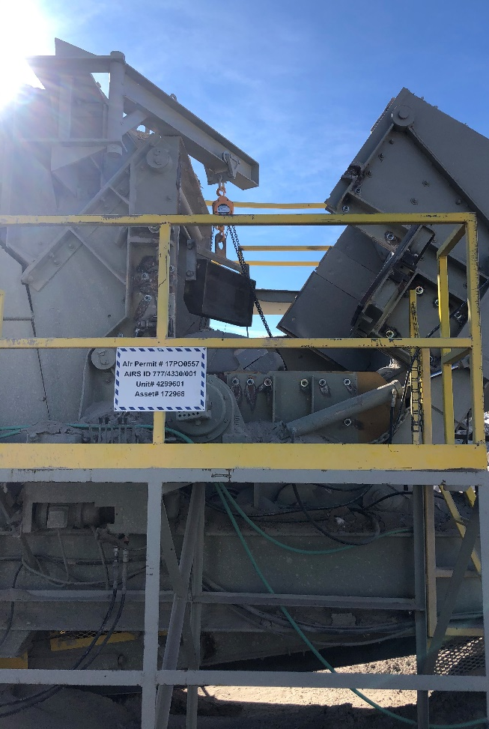
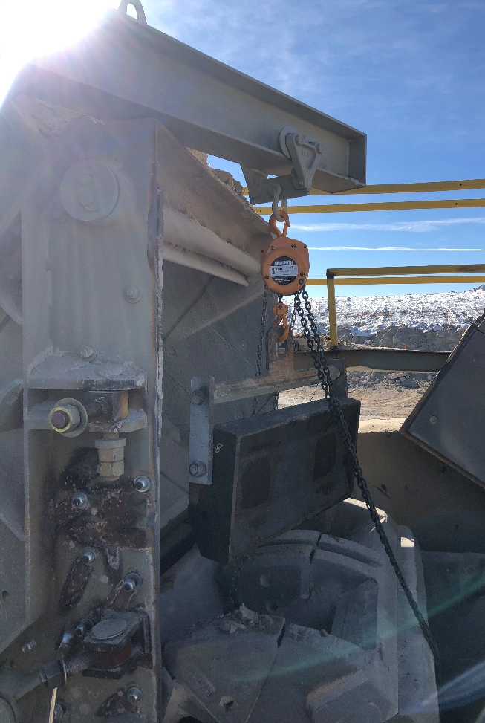
2020 Safety Innovation Award
Davit Arm Installation on Crusher
Travis Newman Martin Marietta
Notes:
Travis Newman approached management with his idea to install a davit arm on his impactor crusher in order to perform routine crusher maintenance more safely (i.e. replacing blow bars). The incorporation of the davit arm has allowed the crew to eliminate the use of a large loader with a stinger and all of its associated hazards – large equipment operating in a tight area, lack of ability for verbal communication between employees and lack of equipment control. The crew is now able to have better control over the blow bar while being maneuvered, as well as maintain better social distancing in the midst of the COVID-19 pandemic. Travis’s innovation has eliminated risks while simultaneously improving a maintenance process. This davit arm was designed, built, and installed in house.

